Slide 1


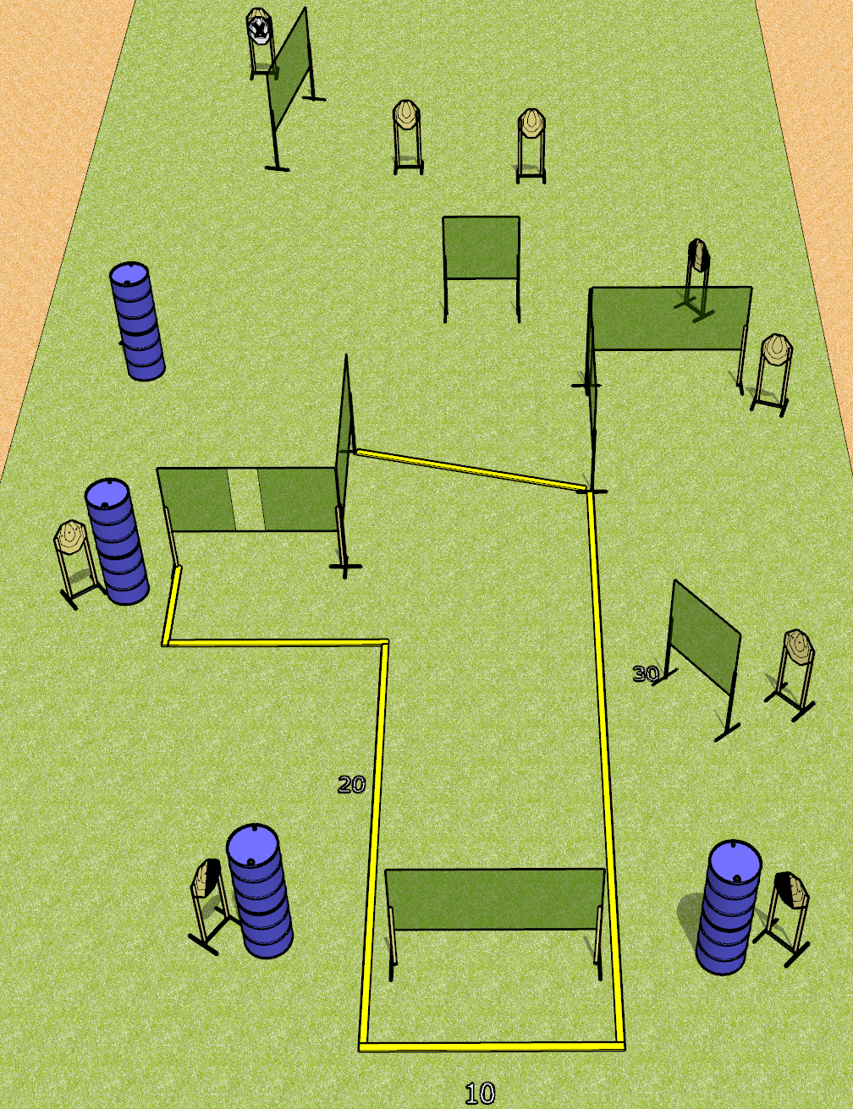
 | Dothan Gun Club – USPSA Match We Have Ways Course Designer : Drew Coleman
Round Count 20 rounds 10 IPSC
Equipment List 14 wall feet 1 left + 1 right dia, 1 tux 8 targets (7 + 1 NS)

Slide 2
We Have Ways
Written Stage Briefing
We Have Ways is a 20 round, 100-point, Comstock course of fire. There are 10 IPSC targets. The best 2 hits will score.
Handgun start position is anywhere completely outside the shooting area, wrists below belt.. Handgun is loaded and holstered.
PCC start position is anywhere completely outside the shooting area, stock on belt. Loaded carbine is held with both hands, safety on.
On the audible start signal, engage targets as they become available from within the shooting area.

